Slide 1
Digital Technologies and Health Coaching
Presentation 1
Mike Leaf, Associate for Innovation Agency
Matt Jameson Evans, HealthUnlocked

Slide 2
Background

Slide 3
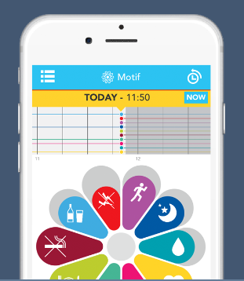
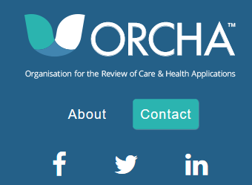
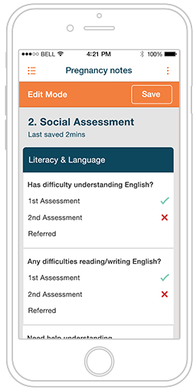
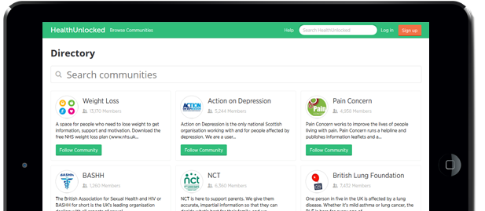
Digital Health Technologies
In 2015:
What percentage of the adult population had a smart phone?
What percentage of households owned a tablet device?
On average, how many hours a day are spent on our smart phones?
What percentage of UK premises are able to receive a superfast broadband service?
How many health and care apps were there in 2015?
66%
54%
2 hours a day
83%
165,000

Slide 4
"For the first time, the smartphone has overtaken the laptop as the device internet users say is the most important for connecting to the internet“
(OfCom, 2015)

Slide 5
How can Digital Health Technology support a health coaching approach?

Slide 6
Digital Platform Case Study
@healthunlocked
www.healthunlocked.com

Slide 7
7 in 10 patients living with a chronic condition have never met anyone with the same illness before*
*Multiple HealthUnlocked User Surveys (latests Feb 2016 n=4096)
@healthunlocked
www.healthunlocked.com

Slide 8
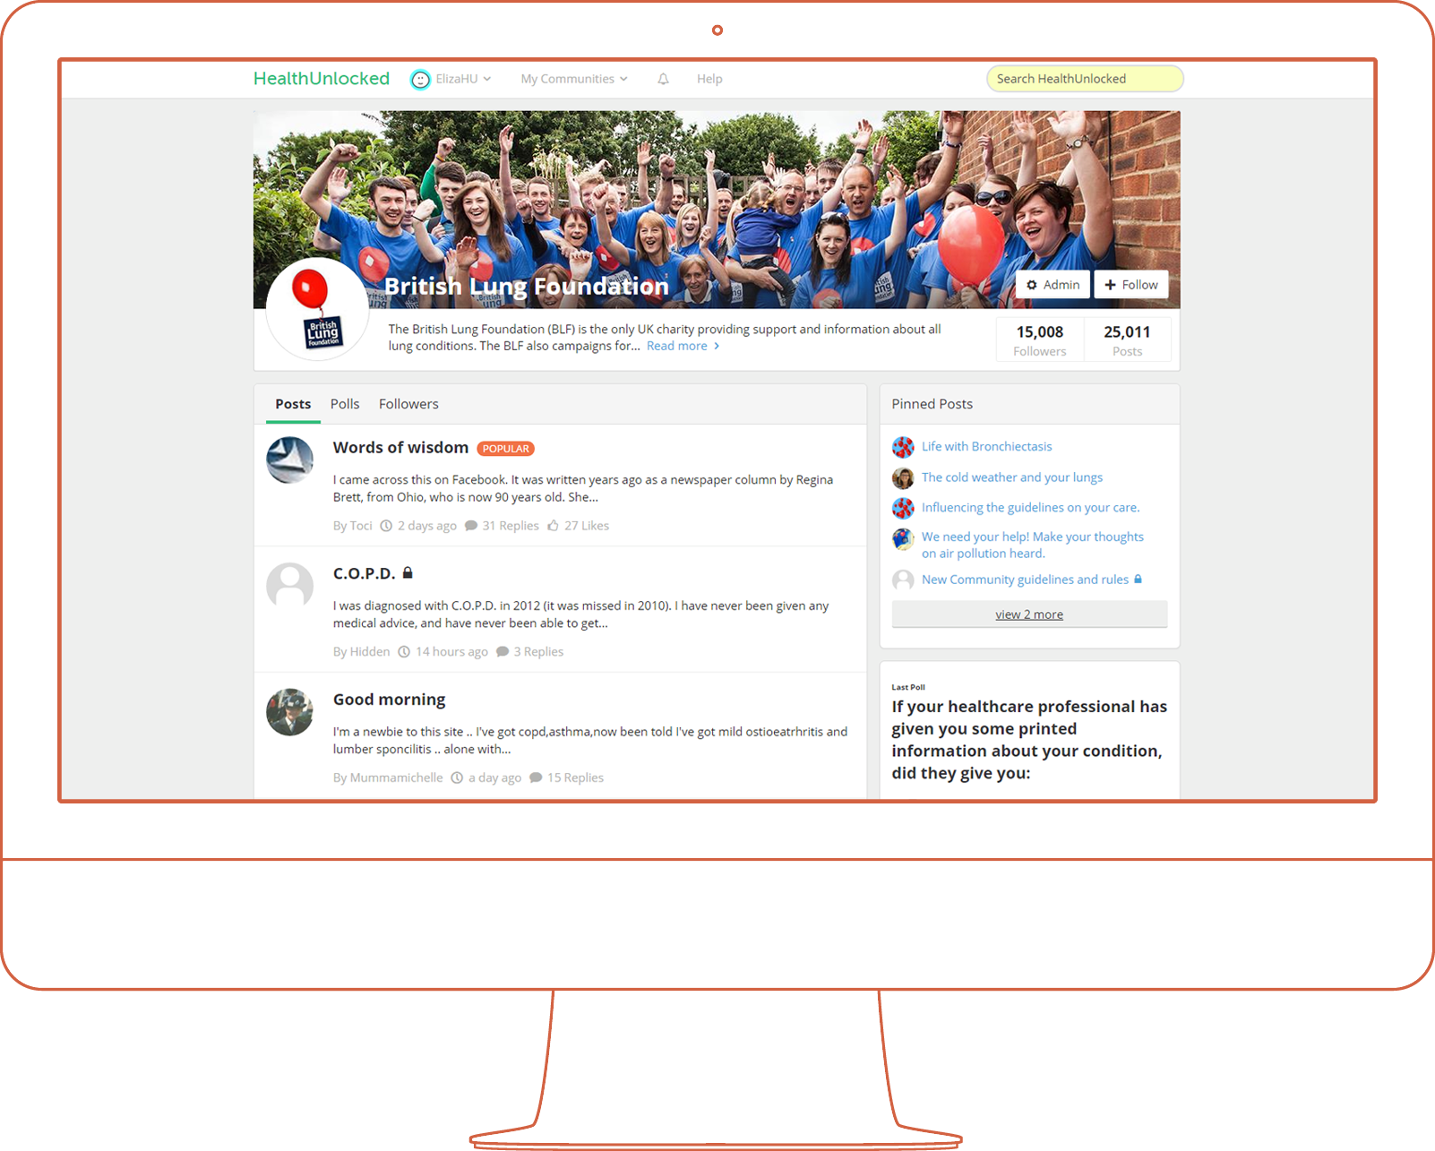
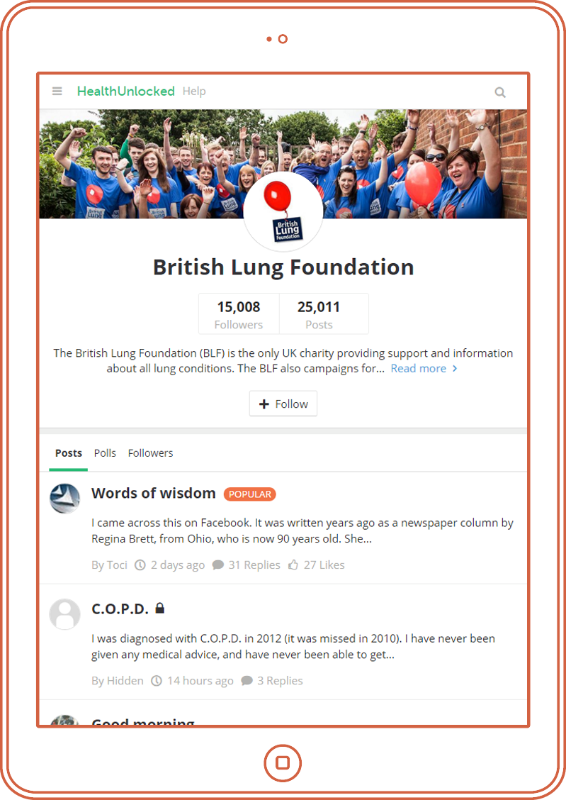
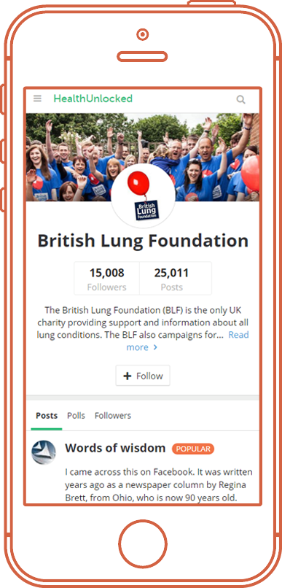
Self care: part of the solution
>600
Communities
490,000
Members
5MM
Visits/Month
160 different disease areas (as well as lifestyle/wellbeing communities)
Highly engaged core of network who actively contribute
70% Google
Remainder: NHS, Partners sites etc
@healthunlocked
www.healthunlocked.com

Slide 9
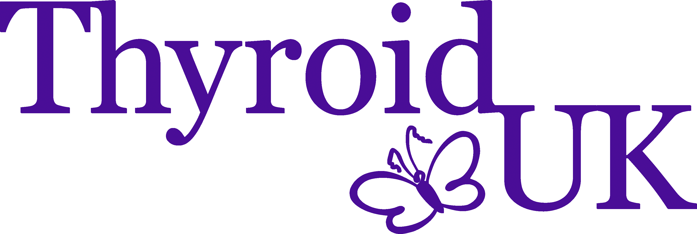
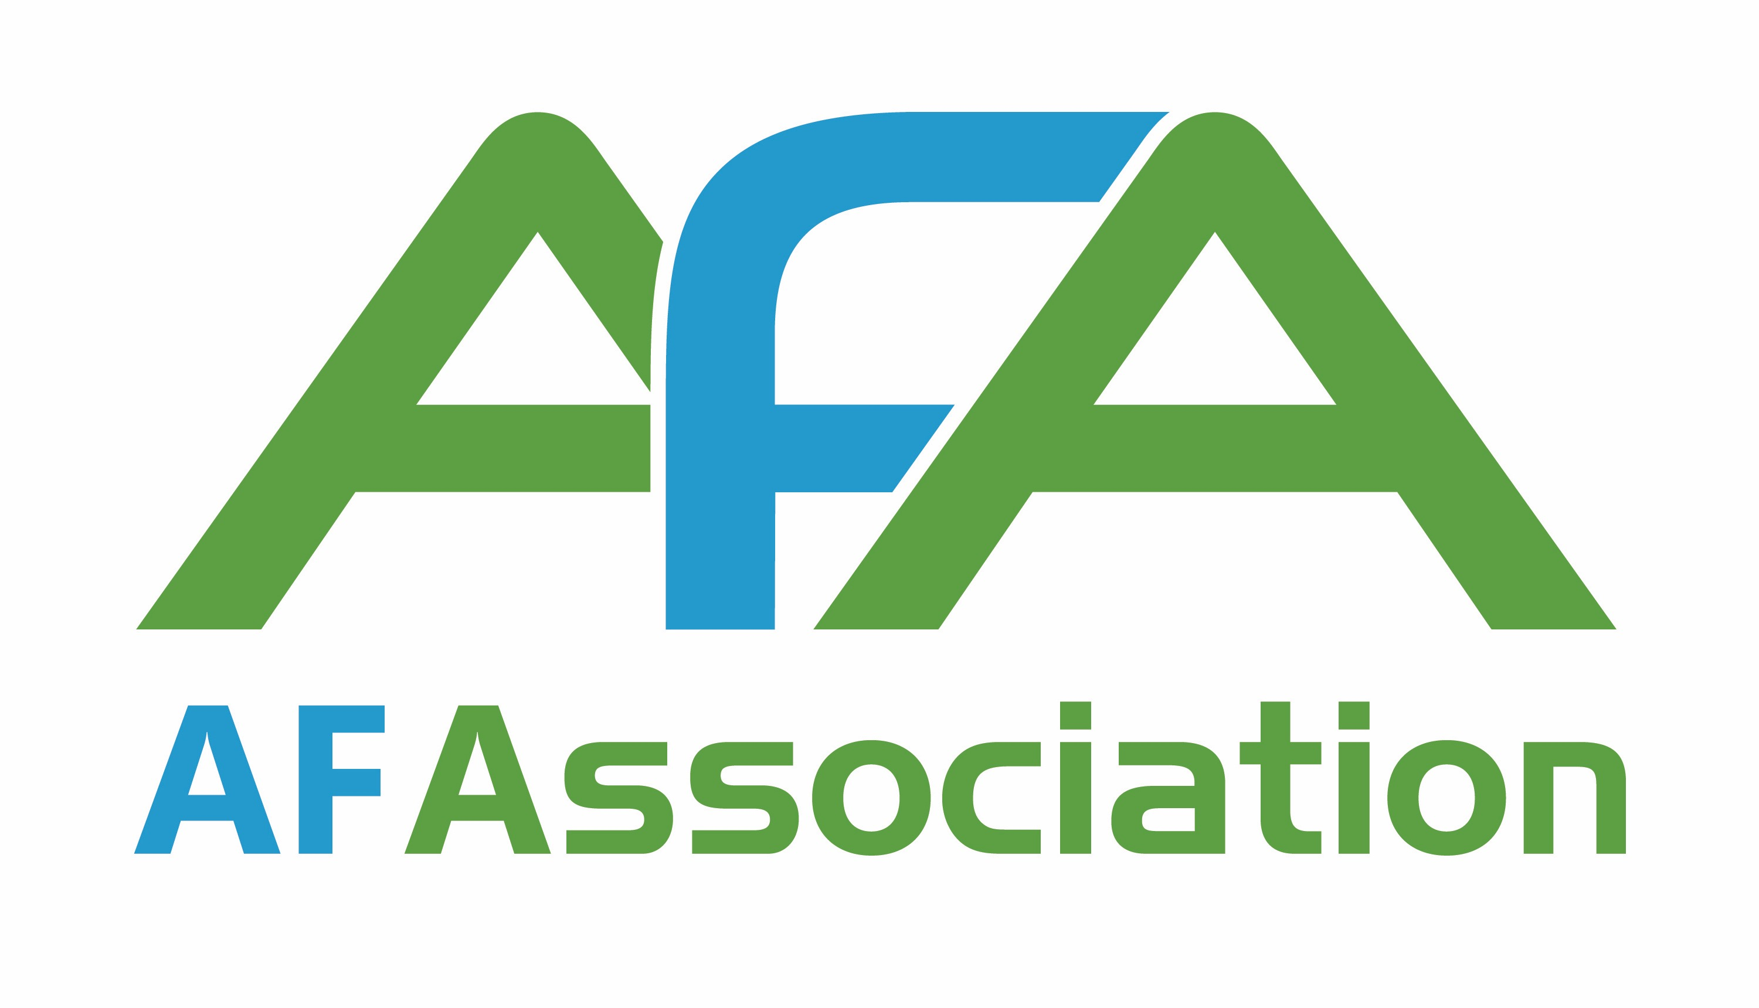
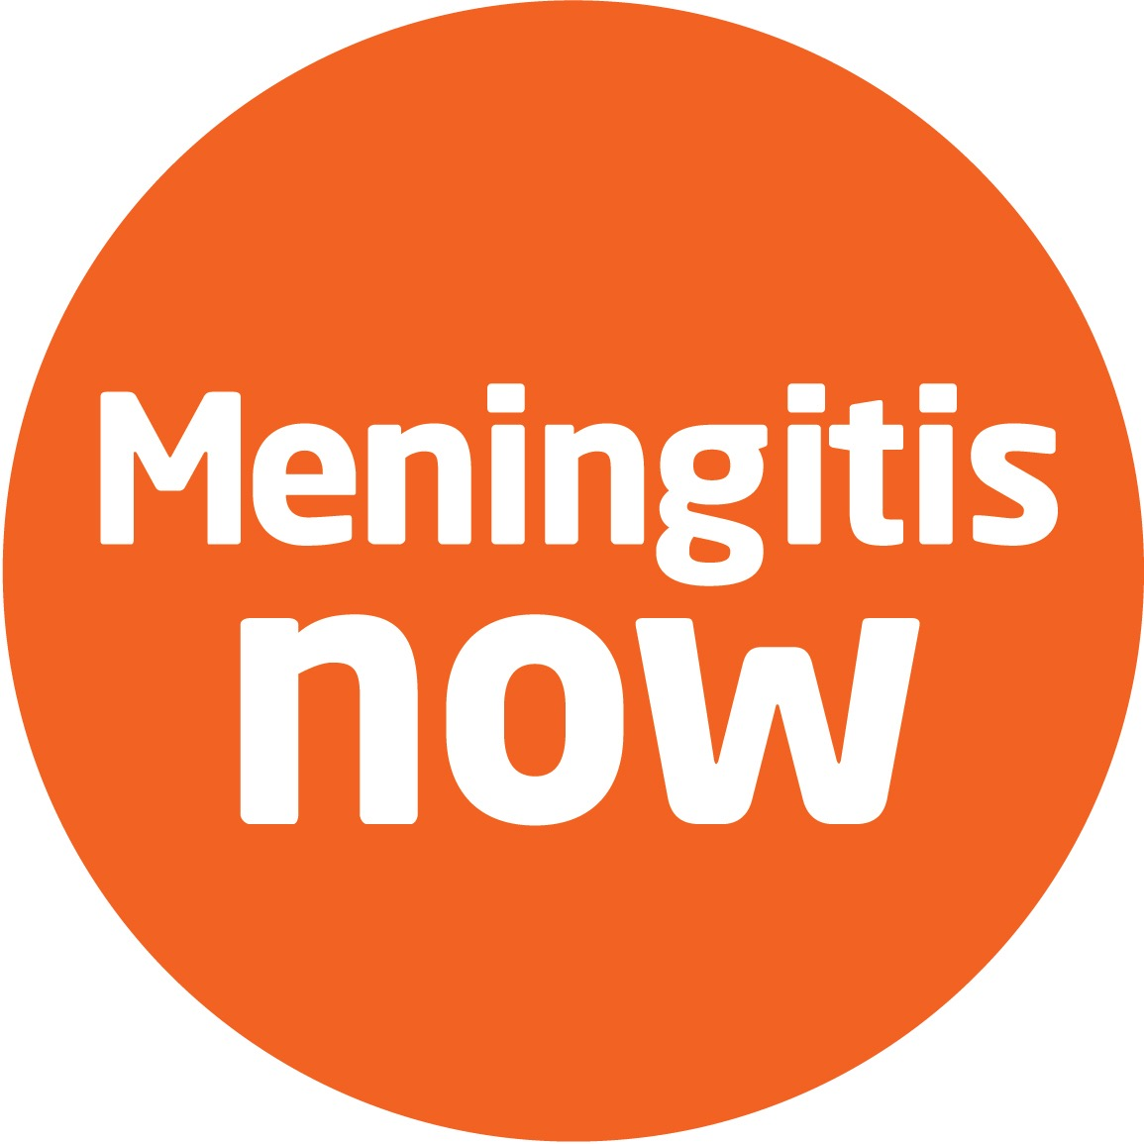
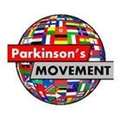
Voluntary
Sector
Network
@healthunlocked
#UnlockYourHealth
healthunlocked.com
www.healthunlocked.com
Notes:
We created our own Artificial Intelligence and that is really the secret sauce of our model.
What is it? It is basically a very clever database that is capable to structure all our users’ content and behaviour. That is from the free text I write in a post to the amount of time that I spend on a given page, and the pages I visited after that page, and so on.
And why structuring the data is so important? Because once all that data is structured, we can then let our algorithms to do their job and recommend the relevant content and services to our users.

Slide 10
Does it work?*
i
68%
50%
89%
18%
had never known anyone else with the same condition
felt more confident managing their condition daily
have better knowledge about treatment options
report that they use clinical services less
*User Survey Feb 2016 n=4096
@healthunlocked
www.healthunlocked.com

Slide 11
Does it work?*
HealthUnlocked*
UK Population**
43 %
Low Activation
45 %
Low Activation
‘Snapshot’ activation levels
*HealthUnlocked- Feasibility study; n=100
**Picker Institute Europe Study (2005); n=2,879
@healthunlocked
www.healthunlocked.com
Notes:
Does it work? With more than 400 thousands members and a rapidly growing users base of 3 million people a month, HealthUnlocked is today the largest Social Platform in the world.
And it is getting truly global. Today the US leads our users base with 36% of the total traffic whereas the UK represents 34% and the rest of the world, including Spanish and Portuguese speaking countries, the other 30%.

Slide 12
Profiling Needs
Rheumatoid Arthritis
Macular Degeneration
Devon
Torquay
Plaquenil
NSAIDS
MTX
Weight Loss
Clinical Trials
Patient Activation Measure
Awareness
At-Risk
Care Seeking
Diagnosis
Treatment Initiation
Treatment Switch
Stability
Decline
@healthunlocked
www.healthunlocked.com

Slide 13
Meet Patients
like you
Find best posts
Find
Clinical
Trials
Local
Services
Take Part in Surveys
Signposting
based on
needs
Selfcare
Workstreams
Care
plans
Health Coaching
Connect with Care
Online
Coaching/
Apps
@healthunlocked
www.healthunlocked.com
Notes:
We created our own Artificial Intelligence and that is really the secret sauce of our model.
What is it? It is basically a very clever database that is capable to structure all our users’ content and behaviour. That is from the free text I write in a post to the amount of time that I spend on a given page, and the pages I visited after that page, and so on.
And why structuring the data is so important? Because once all that data is structured, we can then let our algorithms to do their job and recommend the relevant content and services to our users.

Slide 14
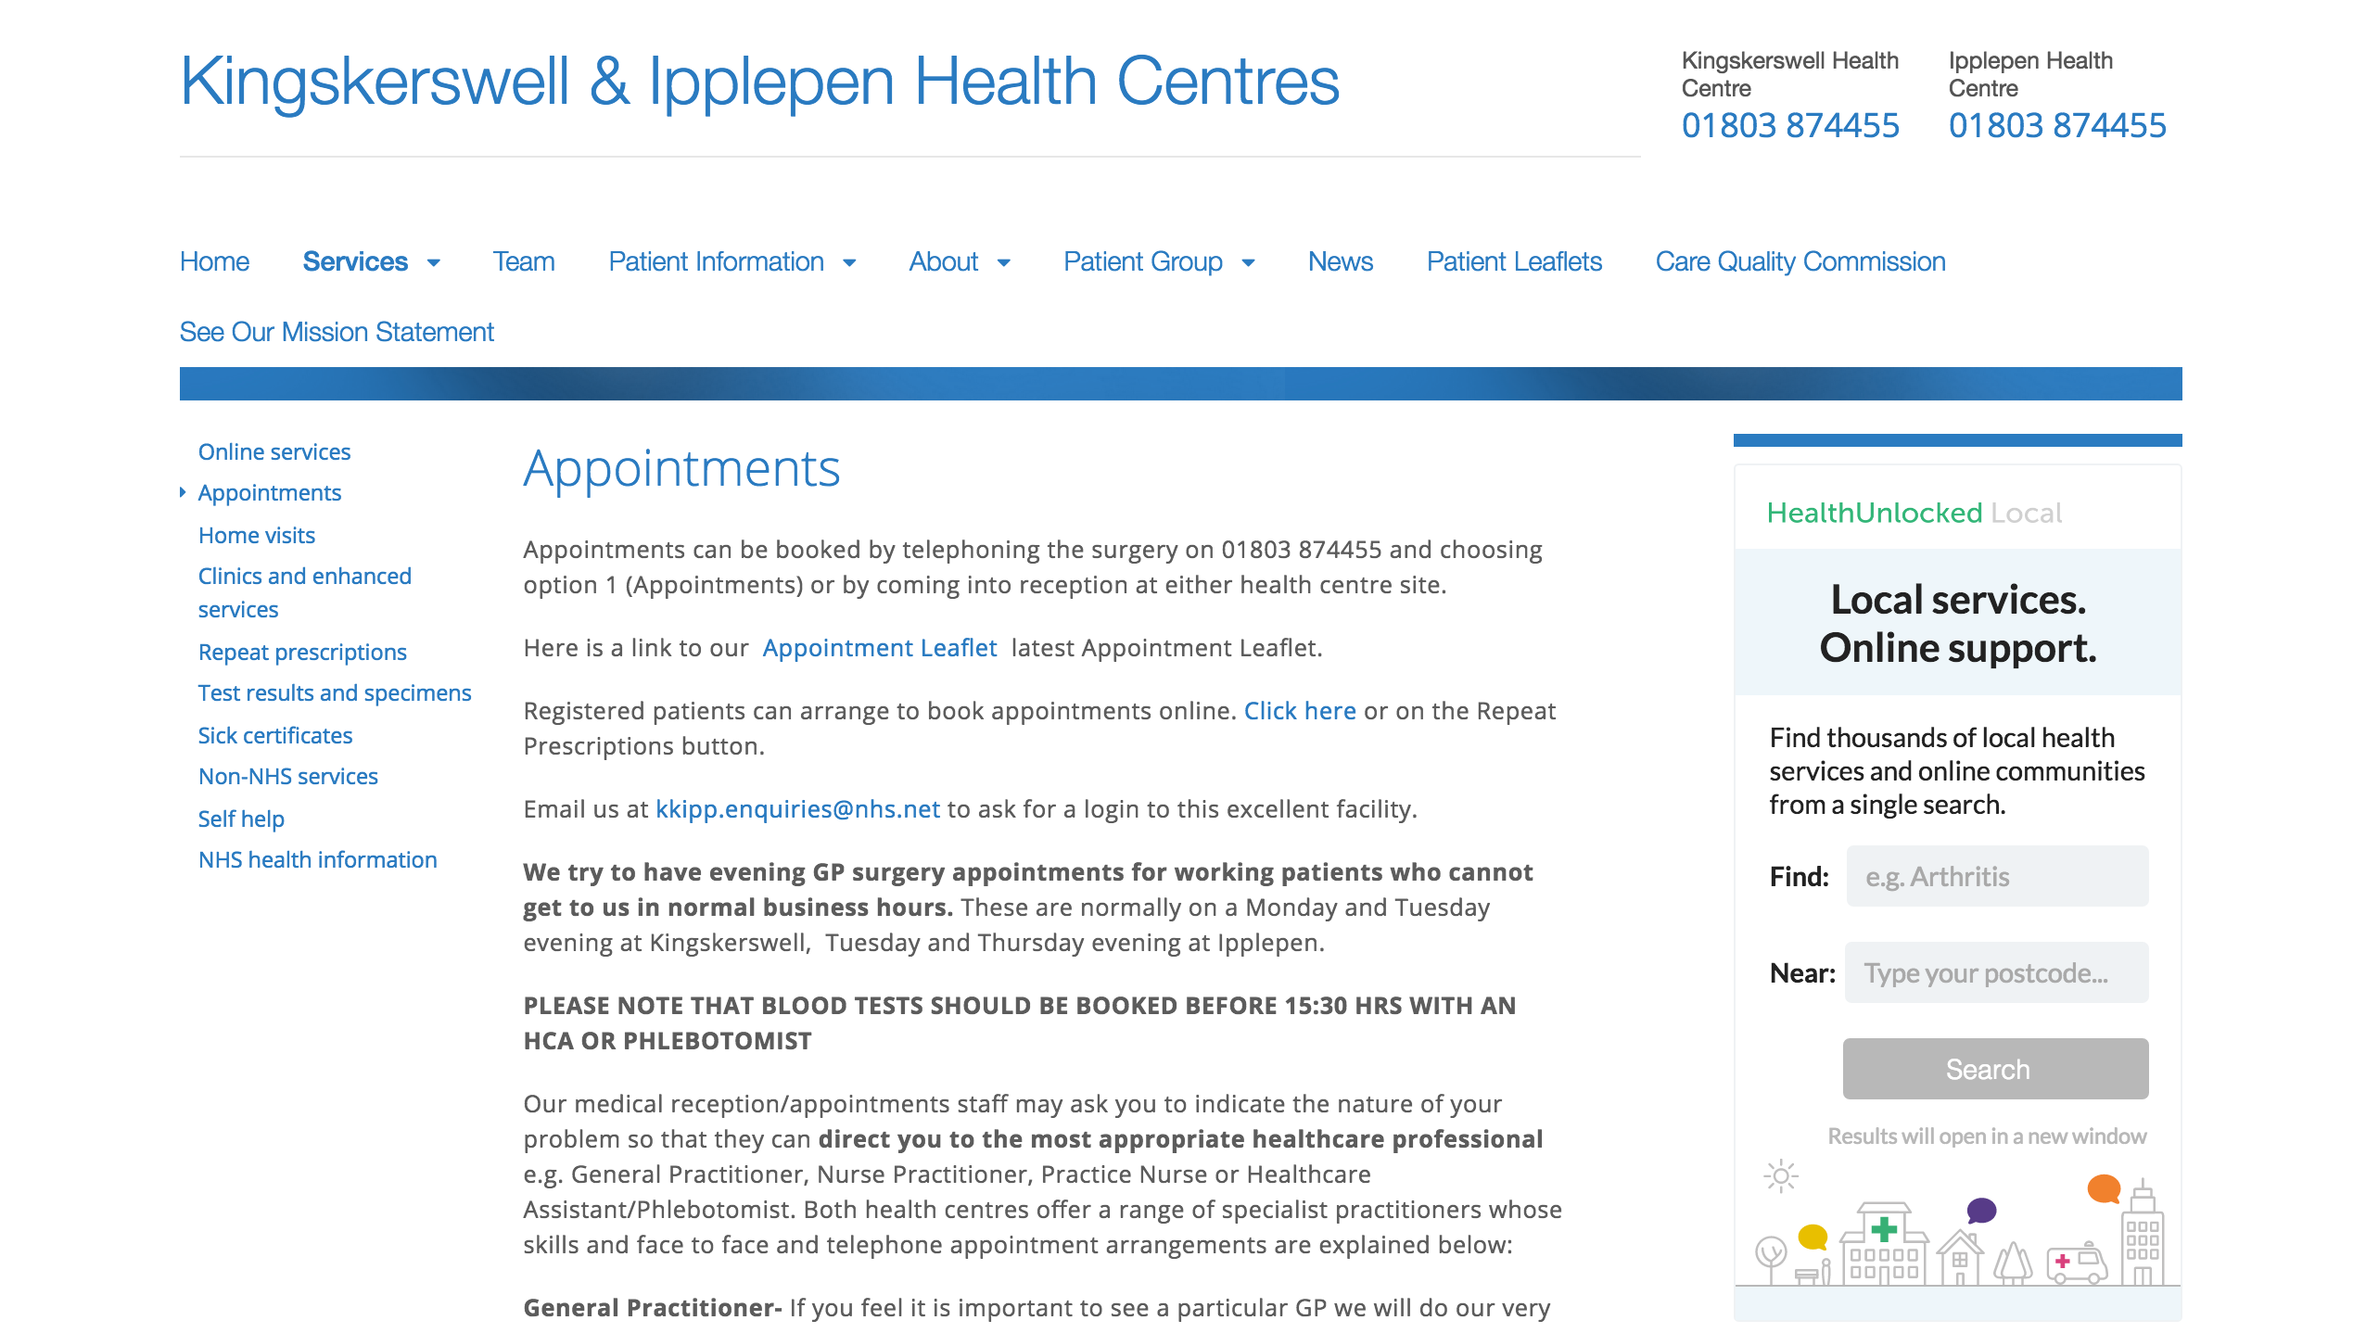
@healthunlocked
www.healthunlocked.com
Notes:
We created our own Artificial Intelligence and that is really the secret sauce of our model.
What is it? It is basically a very clever database that is capable to structure all our users’ content and behaviour. That is from the free text I write in a post to the amount of time that I spend on a given page, and the pages I visited after that page, and so on.
And why structuring the data is so important? Because once all that data is structured, we can then let our algorithms to do their job and recommend the relevant content and services to our users.

Slide 15
Questions?
Notes:
•

